Slide 1
Orientation
Baking and Pastry Arts

Slide 2
Agenda
Welcome
Introduction of Instructors
Programs of Study
Requirements
Uniform Policy
Knives and Tools
Work-Based Learning
Tour of the Kitchen

Slide 3
Welcome!!!!
Overview of the Baking Program
History of our program
ACF Accreditation
The typical student

Slide 4
What Can I Expect?
Degrees, Diplomas, Certificates
Full- or Part-time
Class size and group work
Work Opportunities
Costs: tuition and fees, books, knives and tools, uniforms

Slide 5
Instructors
Jeff Hadley, Department Head
Caralyn House, Baking Program Director
Eric Stopka
Melissa Attanas
Josephine Herbert

Slide 6
JEFF HADLEY Department Head and Chef Instructor
Chef Hadley began his career in foodservice at the age of 16 when he worked as a busboy and dishwasher at a restaurant in his hometown of Pittsburgh, Pennsylvania. He was bitten by the bug and has worked in the field ever since. A graduate of Northwood University with degrees in Culinary Arts and Hotel/ Restaurant Management, Chef Hadley has worked in nearly every facet of the business. His greatest amount of experience comes from managing upscale hotel kitchens and clubs. Hadley’s affiliation began with Wake Tech in 1989 as an industry advisor and since 2001, as a culinary instructor. He has been the Department Head since 2008. Outside of work, he enjoys mountain biking and NASCAR.
Chef Hadley is also responsible for the coordination of the exchange program with a hotel/ culinary school in France. He has participated in a program called Adopt-A-Ship, which pairs chefs with a Navy ship. The chef conducts training classes while on board the ship while they are at sea. His most recent trip took him to Japan for three weeks. He is a Certified Hospitality Educator (CHE).
jjhadley@waketech.edu
919-866-5990

Slide 7
Caralyn House Lead Baking Instructor, Associate Department Head
Chef House has a degree in Finance and Banking from Appalachian State University. She also studied at L'Academie de Cuisine in Bethesda, Maryland, earning an Associate’s Degree in Culinary Arts. Chef House won a scholarship to study Pastry Arts taught by the White House pastry chef, Roland Mesnier. She has worked in restaurants in the Washington, DC, area as well as Raleigh, NC.
Chef House has been teaching a variety of classes at Wake Tech since 1991. She now focuses on the baking and pastry classes, and is the Program Director for the Baking and Pastry Arts program. She is a Certified Hospitality Educator (CHE), and was awarded the 2007 Excellence in Teaching Award by the North Carolina Community College System.
cmhouse@waketech.edu
919-532-5969

Slide 8
Eric Stopka
Eric Stopka has a degree in Broadcasting and Communications from East Carolina University and an Associate’s Degree in Baking and Pastry from Wake Technical Community College. He began his career in the foodservice industry at the age of 17 as a dishwasher and a prep cook, working his way up in the kitchen from prep cook to Sous Chef to Assistant Manager at many different restaurants across NC.
His love of pastry led him to receive a degree from Wake Tech and then work at the prestigious Fearrington House restaurant as Lead Pastry Cook where he helped the restaurant maintain the triple, five diamond award status. He then went on to work at Whole Foods Market as a Bakery Manager. Eric has been teaching at Wake Tech since 2012 as an adjunct teacher and in the Fall of 2016 came onboard as a full time teacher. He loves teaching and enjoys working with the students in achieving their personal and professional goals.
ecstopka@waketech.edu
919 – 532-5970

Slide 9
Melissa Attanas
Chef Melissa Attanas developed a passion for food, baking and cooking at a young age. While still in high school, she began her career working all the stations in a small French restaurant kitchen in Eastern North Carolina. She loved it so much that after graduating she went on to earn an AAS in Culinary Arts at Wake Technical Community College in 2003. She has experience working in award winning institutions including Hayes Barton Café in Raleigh, Magnolia Grill in Durham, and Bon Appetit Management Company at SAS in Cary.
Melissa has 20 years of experience in different facets of the food and restaurant industry under her belt and knows a lot about the hard work and dedication it takes to be successful in a baking and pastry arts career. At each step in her career, she found herself mentoring beginners and soon realized her passion for teaching was as great as her passion for baking. One of her favorite things about her work experience was getting to mold people new to professional kitchen work.
In 2010, Melissa began working as an adjunct baking instructor at WTCC’s Southern Campus while working full time in the restaurant industry. Inspired by the positive impact Wake Tech has on the community, she decided to go full time as a baking instructor at the new Northern Wake Campus kitchen in 2017. She describes her teaching style as firm and consistent while encouraging her students to develop a passion for their work.
mrattanas@waketech.edu
919-532-5971

Slide 10
Josephine Herbert
Chef Hebert has a degree in Baking and Pastry Arts from Johnson and Wales University. She has over 12 years of experience in the field.
Out of college she started working at an independent bakery and worked her way up to head baker. In 2012 she relocated to New York and worked in an upscale Italian bakery; this is where she fell in love with the passion of cake decorating.
Later Chef Herbert went on to become a Pastry Chef and manager at North Carolina State University and Bon Appetit Management Company at SAS in Cary, NC. Managing opened her eyes to the importance of training and the understanding of hard work, dedication, and commitment to the food service industry.
Chef Herbert began as an adjunct instructor in the baking program at Wake Tech in fall 2020, impressed with the impact the program has on the community even during a pandemic. She joined the faculty full-time in January 2021. Chef Herbert is grateful for the opportunity to guide and mold future pastry chefs, and her enthusiasm is evident in the classes she teaches.
Chef Herbert enjoys spending time with her family, being bossed around by her Sheepadoodle Eddie, attending sporting events, and being at the beach.
jcherbert@waaketech.edu

Slide 11
Adjunct Instructors
Our adjunct instructors may change each semester. They are industry professionals who take time out of their busy schedules to teach a class or two. Each is a specialist in their area.
Recent adjunct instructors include:
Kelly Kieffer
Cassandra Myers
Kaitlyn Walker

Slide 12
Programs of Study
Culinary
Baking
Hospitality
Degrees and Diplomas
Adding Certificates
Advising – especially if you are considering adding a certificate, or double/triple majoring

Slide 13
Academic Requirements
Pre- and Co-Requisites
ServSafe Certification – required of every student, and part every student’s first semester
General Education Credits
Can be transferred from another school or curriculum
ENG 111 and ENG 112 or ENG 114 (take 2 of these)
MAT 110
PSY 118
HUM 115

Slide 14
Baking and Pastry Arts Degree Fall Start Date
CUL 110 Sanitation and Safety
FALL 2nd 8 Weeks
CUL 260 Baking II
CUL 142 Fundamentals of Food
CUL 160 Baking I
BPA 120 Petits Fours and Pastries
SPRING 1st 8 Weeks
CUL 112/CUL 112A Nutrition for Food Service/Lab
BPA 130 European Cakes and Tortes
BPA 210 Cake Design and Decorating
BPA 220 Confection Artistry
BPA 150 Artisan and Specialty Breads
HRM 245 Human Resource Management
FALL 1st 8 Weeks
SPRING 2nd 8 Weeks
Take Any Semester
FALL
1st 8 Weeks
FALL
2nd 8 Weeks
BPA 230/BPA 230A Chocolate Artistry/Lab
BPA 260 Pastry and Baking Marketing
WBL 112 Work-Based Learning
BPA 240 Plated Desserts
BPA 250 Dessert and Bread Production
WBL 112 Work Based Learning
PSY 118 MAT 110
ENG 111 ART 131/HUM 115
ENG 112 or ENG 114
CUL 150 Food Science

Slide 15
 | Course Title | Online, Hybrid, Seated | Pre-Requisite | Co-Requisite | Hours Per Week/ Class | Hours Per Week/ Lab | Semester Credits | Term Offered (F=Fall, S=Spring, SU=Summer)
 | First Semester - First 8 Weeks - Fall
 | CUL 110 (Sanitation and Safety) | H | None | None | 2 | 0 | 2.0 | F, S, SU
 | CUL 142 (Fundamentals of Food) | S | None | CUL 110 | 2 | 6 | 5.0 | F, S, SU
 | CUL 160 (Baking I) | S | None | CUL 110 and CUL 140 or CUL 142 | 1 | 4 | 3.0 | F, S, SU
 | First Semester - Second 8 Weeks - Fall
 | BPA 120 (Petits Fours and Pastries) | S | CUL 160 | None | 1 | 2 | 3.0 | F, S, SU
 | CUL 260 (Baking II) | S | CUL 160 | None | 1 | 4 | 3.0 | F, S
 | *Eligible for Baking Certificate at this point.
 | CUL 150 (Food Science) | H | CUL 110, CUL 140/142 | None | 1 | 2 | 2.0 | F, S
 | Second Semester - First 8 Weeks - Spring
 | BPA 210 (Cake Design and Decorating) | S | CUL 160 | None | 1 | 4 | 3.0 | F, S
 | BPA 220 (Confection Artistry) | S | CUL 160 | None | 1 | 6 | 4.0 | F, S
 | CUL 112 (Nutrition for Foodservice) | H | CUL 110 and 140/142 | None | 3 | 0 | 3.0 | F, S, SU
 | CUL112A (Nutrition for Foodservice Lab) | H | CUL 110 and 140/142 | CUL 112 | 0 | 3 | 1.0 | F, S, SU
 | Second Semester - Second 8 Weeks - Spring
 | BPA 150 (Artisan & Specialty Breads) | S | CUL 160 | None | 1 | 6 | 4.0 | F, S
 | BPA 130 (European Cakes and Tortes) | S | CUL 160, CUL 260 | None | 1 | 4 | 3.0 | F, S
 | HRM 245 (Human Resource Management) | O, H | None | None | 3 | 0 | 3.0 | F, S, SU
 | Third Semester - First 8 Weeks - Fall
 | BPA 260 (Pastry and Baking Marketing) | H | BPA 150, BPA 210 | BPA 250 | 2 | 2 | 3.0 | F, S
 | BPA 230 (Chocolate Artistry) | S | CUL 160 | BPA 230A | 1 | 4 | 3.0 | F, S
 | BPA 230A (Chocolate Artistry Lab) | S | CUL 160 | BPA 230 | 0 | 2 | 1.0 | F, S
 | WBL 132 (Work-Based Learning, 16 Weeks) | H | Petition-restricted class | Varies | 0 | 20 | 2.0 | F, S, SU
 | Third Semester - Second 8 Weeks - Fall
 | BPA 240 (Plated Desserts) | S | CUL 260 | None | 1 | 4 | 3.0 | F, S
 | BPA 250 (Dessert/Bread Production) | S | BPA 150 | BPA 260 | 1 | 8 | 5.0 | F, S
 | General Education – Take Any Semester
 | PSY 118 (Interpersonal Psychology) |  | None | None | 3 | 0 | 3.0 | F, S, SU
 | ENG 111 (Writing and Inquiry) |  | See R.I.S.E. requirements | None | 3 | 0 | 3.0 | F, S, SU
 | MAT 110 (Math Measurement & Literacy) |  | See R.I.S.E. requirements | None | 2 | 2 | 3.0 | F, S, SU
 | ART 131 or HUM 115 (Humanities/Fine Arts Elective) |  | Varies | Varies | Varies | Varies | 3.0 | F, S, SU
 | ENG 112 (Writing/Research) |  | ENG 111 | None | 3 | 0 | 3.0 | F, S, SU
Baking and Pastry Arts 2016SU*A55130
A.A.S. Degree (Day)

Slide 16
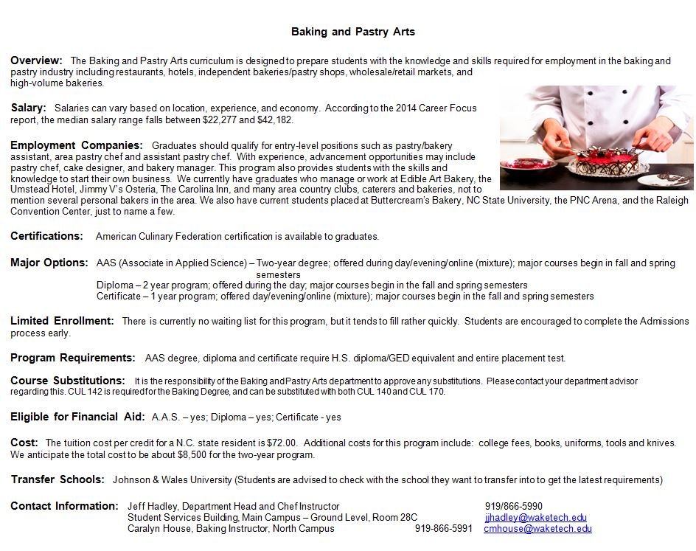

Slide 17
Technical Requirements
Being in the restaurant industry is a very demanding profession
Communication
Physical Strength and Stamina
Mobility and Motor Skills
Sensory
Interpersonal and Emotional

Slide 18
Knives and Tools
Baking Kit
The tool kit required for
Baking Majors is posted
on the baking website
and is available in
the bookstore. You may
purchase items on your
own as well.

Slide 19
Knives and Tools
Culinary Kit
The tool kit required for Culinary Majors is posted on the culinary website and items are
available in the bookstore.

Slide 20
Work-Based Learning and Employment Resources
Why required
Requirements
Employment resources https://www.waketech.edu/student-services/careers-employment

Slide 21
Once I Graduate, What Can I Expect?
Where can I find work after I graduate?
As a graduate, you can apply for Certified Culinarian® (CC®) or Certified Pastry Culinarian® (CPC®) with the American Culinary Federation (ACF).
Can I transfer to another school?
Will any of my credits transfer?

Slide 22
Tour of the Kitchen
Questions?
Comments?
How to contact us:
Jeff Hadley, Department Head for Culinary, Baking, and Hospitality Programs jjhadley@waketech.edu 919-866-5990
Caralyn House, Baking Program Director, 919-532-5969, cmhouse@waketech.edu.
Tour of Kitchen
Culinary, Baking and Hospitality Website: https://www.waketech.edu/about-wake-tech/divisions/business-public-services-technologies/culinary-hospitality

Slide 23
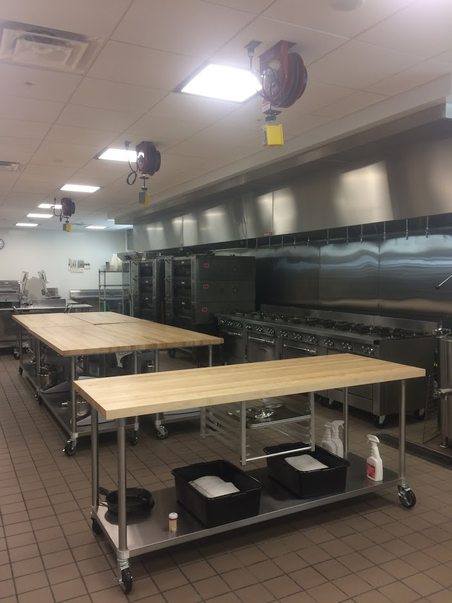
Baking Kitchen Photos

Slide 24
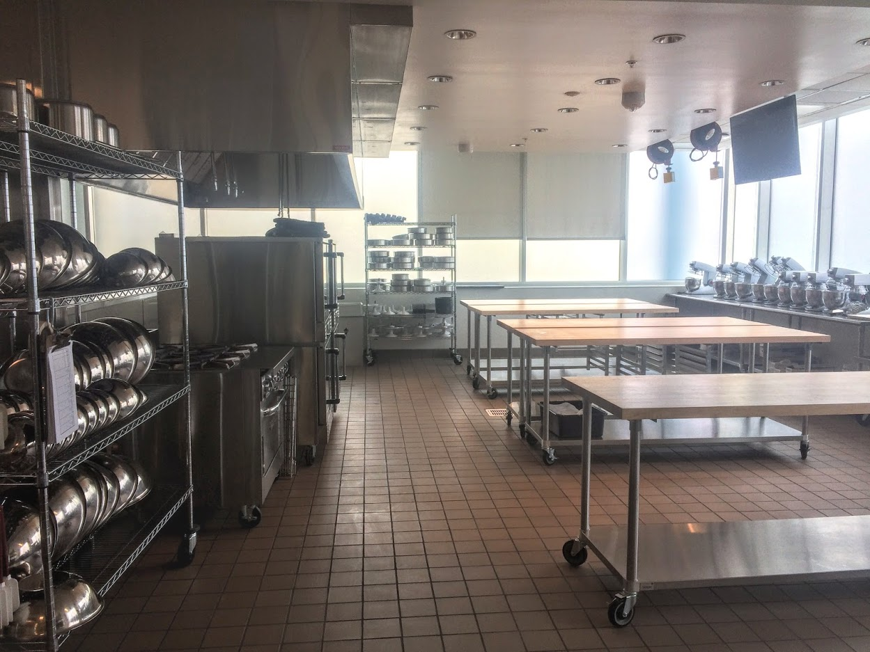
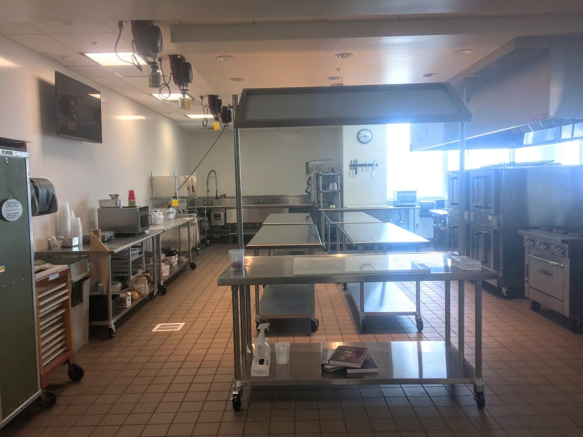

Slide 25
Students and Chefs in Action

Slide 29
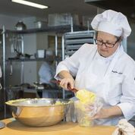
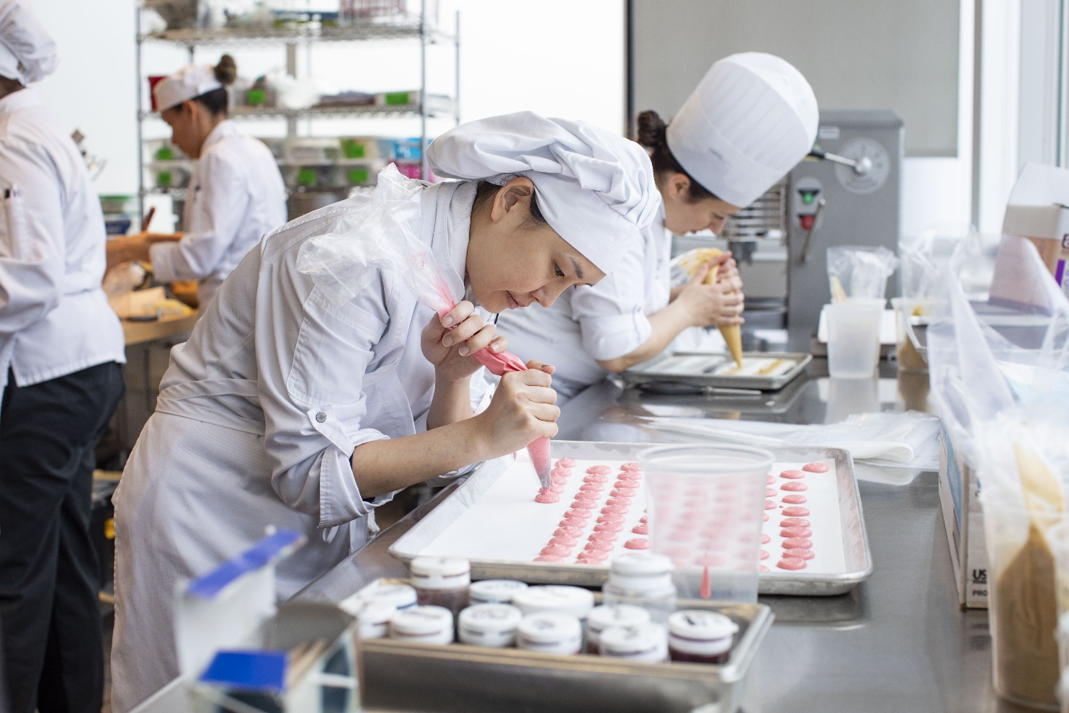

Slide 30
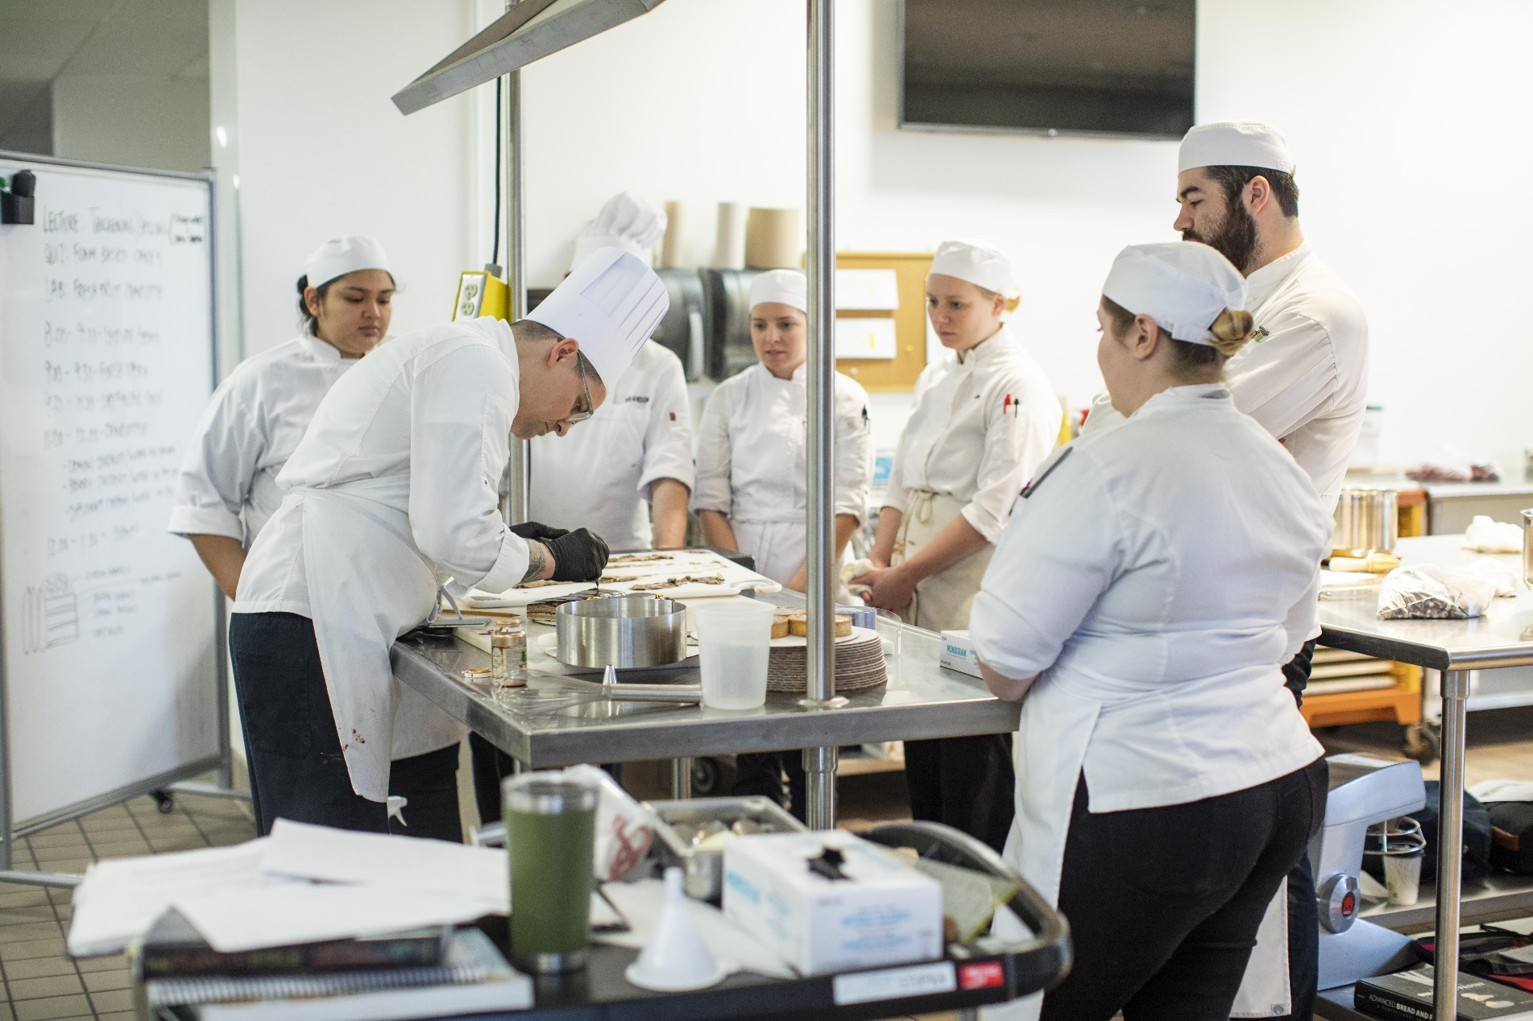

Slide 31
