Slide 1
Orientation
Culinary, Baking, and Hospitality Management Degree Programs

Slide 2
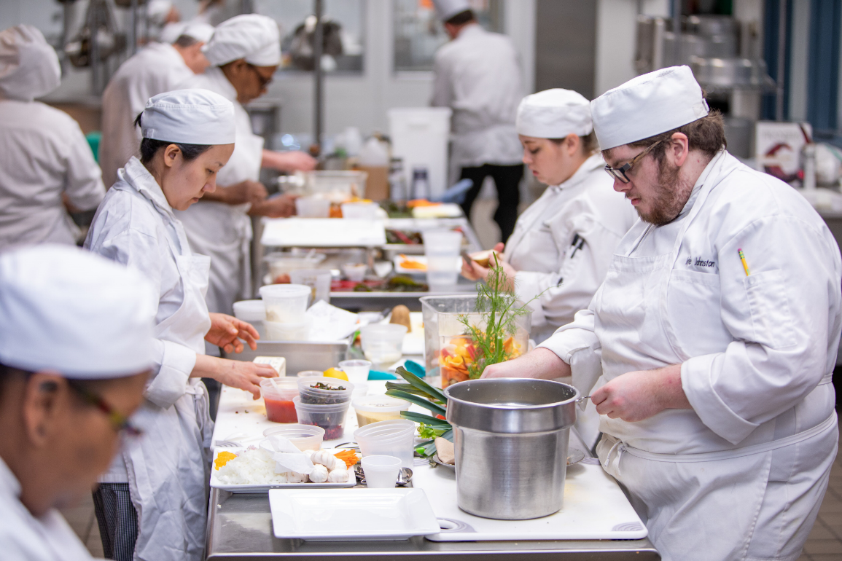
Agenda
Welcome
Introduction of Instructors
Programs of Study
Requirements
Uniform Policy
Knives and Tools
Flavors Restaurant
Work-Based Learning
Tour of the Kitchen

Slide 3
Welcome
Overview of the Culinary, Baking, and
Hospitality Programs
History of our program
ACF Accreditation
The typical student

Slide 4
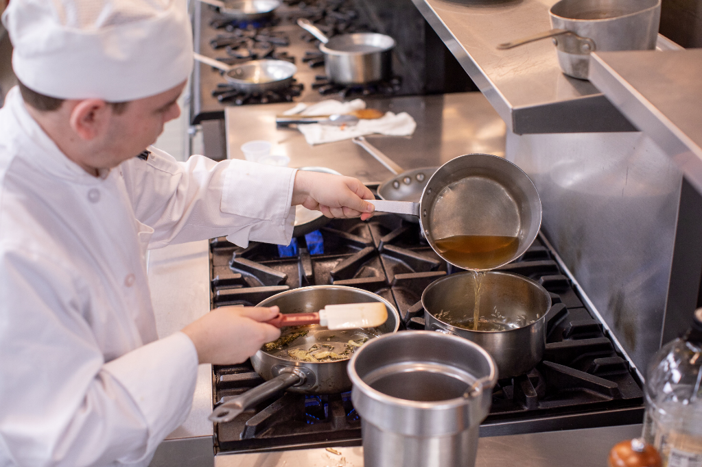
What Can I Expect?
Degrees, Diplomas, Certificates
Full- or Part-time
Class size and group work
Work Opportunities
Costs: tuition and fees, books, knives and tools, uniforms

Slide 5
Instructors
Click on link for chef bios.
https://www.waketech.edu/programs-courses/credit/culinary-arts/faculty
Jeff Hadley, Department Head
Jim Hallett
Phil Bales
Aaron Stumb
Caralyn House, Baking Lead Instructor
Leslie DeMarco
Eric Stopka
Melissa Attanas
Heather Therien
Jane Broden, Hospitality Lead Instructor
Suya Campos-Rosa
Adjunct Instructors

Slide 6
Adjunct Instructors
Our adjunct instructors may change each semester. They are industry professionals who take time out of their busy schedules to teach a class or two. Each is a specialist in their area.
Recent adjunct instructors include:
Smith Joslin, Whole Foods Bakehouse Commissary
Corinna Morris, Prestonwood Country Club
Suzanne Downs, Fearrington House Restaurant
Stephanie Nikolic, Bun Buzzed
Aris Ragouzeos, Retired from GSK
Patty Robinson, F & D Huebener, LLC
Brandon Levtzow, Hyatt Hotels
Anthony Wilkens, Another Broken Egg
Barry Schuster, NC Central Hospitality

Slide 7
Programs of Study
Culinary
Baking
Hospitality
Degrees and Diplomas
Adding Certificates - http://www.waketech.edu/programs-courses/credit/hospitality-management/degree-certificates
Advising – especially if you are considering adding a certificate, or double/triple majoring

Slide 8
Academic Requirements
Pre- and Co-Requisites
ServSafe Certification – required of every student, and part of every student’s first semester
General Education Credits
Can be transferred from another school or curriculum
ENG 111 and ENG 112 or ENG 114 (take 2 of these)
MAT 110
PSY 118
ART 131 or HUM 115

Slide 9
CULINARY ARTS
Culinary Arts Degree - A55150-Day Only
The Culinary Arts curriculum provides specific training required to prepare students to assume positions as trained culinary professionals in a variety of food service settings including full service restaurants, hotels, resorts, clubs, catering operations, contract food service, and health care facilities.
Course offerings emphasize practical application, a strong theoretical knowledge base, and professionalism and provide the critical competencies to successfully meet industry demands. Courses also include sanitation, food/beverage service and control, baking, garde manger, American/International cuisines, and hospitality supervision.
Graduates should qualify for entry-level positions such as line cook, station chef, and assistant pastry chef. American Culinary Federation certification is available to graduates. With experience, graduates may advance to positions such as sous-chef, executive chef, or food service manager.
Culinary Arts Diploma - D55150-Day Only
The culinary arts diploma includes basic and more advanced courses to help prepare students for entry into the culinary field or to advance in their current foodservice positions.
Courses address both the art and the science of food preparation. Students learn basic sanitation, cooking and baking principles, and garnishing and presentation skills. Modern supervision techniques are also studied and practiced. The majority of class time is devoted to actual hands on kitchen skill development.
Course credits are transferable to the Culinary Arts associate degree program.
Culinary Arts Certificate - C55150A-Day and Evening
The Culinary Certificate includes basic courses to help prepare students for entry into the culinary field or to advance in their current foodservice jobs.
Courses address both the art and the science of food preparation. Students learn basic sanitation, cooking and baking principles, and garnishing and presentation skills. Modern supervision techniques are also studied and practiced. The majority of class time is devoted to actual hands-on kitchen skill development.
Courses credits are transferable to the Culinary Arts associate degree program.

Slide 10
CULINARY PROGRAM SEQUENCE
First Semester
CUL 110 Sanitation and Safety………………………….2
CUL 140 Culinary Skills I……………………………………5
ENG 111 Writing and Inquiry……………………………..3
MAT 110 Math Measurement & Literacy…………….3
Second Semester
CUL 160 Baking I………………………………………………3
CUL 170 Garde-Manger I…………………………………..3
CUL 240 Culinary Skills II...........................................5
HRM 245 Human Resources Management Hosp…3
Complete Culinary Arts certificate (C55150A):
CUL 110, CUL 140, CUL 160 or CUL 170, CUL 240, HRM 245
Third Semester
CUL 112 Nutrition for Foodservice…………….….......3
CUL 112A Nutrition for Fdsv Lab……………..….….……1
ENG 112 Writing/Research in the Disc………..……...3
HRM 260 Procurement for Hospitality…………..…….3
Fourth Semester
CUL 135 Food and Beverage Service…………………2
CUL 135A Food and Beverage Service Lab…………..1
CUL 250 Classical Cuisine…………………………………5
WBL 112 Work-Based Learning I………………………..2
Fall Elective List I……………………………………………………….….2
CUL 260 Baking II………………………………………..……3
Fifth Semester
CUL 230 Global Cuisines………………………….5
HRM 220 Cost Control-Food and Beverage…3
SPA 120 Spanish for the Workplace………….3
CUL 270 Garde Manager II……………………….3
Sixth Semester
PSY 118 Interpersonal Psychology……………3
Humanities/Fine Arts Elective………………………………3
Complete Culinary Arts Diploma (D55150):
CUL 110, CUL 140, ENG 111, MAT 110, CUL 160, CUL 170, CUL 240, and HRM 245, + Select six credits from HRM 260, HRM 220, and CUL 112/A, and select ten credits from BPA 150, CUL 130, CUL 214, CUL 260 or CUL 270
Fall Elective List (Select one of the following):
CUL 130 Menu Design……………………………2
CUL 214 Wine Appreciation…………………....2
Other Electives
BPA 150 Artisan & Specialty Bread…………..4
WBL 122 Work-Based Learning II…………......2
Humanities Elective (Select one course from the following):
HUM 115 Critical Thinking……………………3
ART 131 Drawing ……………………………….3
Graduation Requirements……………………………...…72 Credit Hours

Slide 11
BAKING & PASTRY ARTS
All core classes are taught in 8 week semesters
Baking and Pastry Arts Degree - A55130-Day Only
The Baking and Pastry Arts curriculum is designed to prepare students with the skills and knowledge required for employment in the baking/pastry industry including restaurants, hotels, independent bakeries/pastry shops, wholesale/retail markets, and high-volume bakeries.
Course offerings emphasizing practical application, a strong theoretical knowledge base, and professionalism provide the critical competencies to meet industry demands. Course work includes specialty/artisan breads, desserts, pastries, candies, decorative work, high-volume production and food marketing.
Graduates should qualify for entry-level positions, such as pastry/bakery assistant, area pastry chef and assistant pastry chef. American Culinary Federation certification is available to graduates.
Baking and Pastry Arts Diploma - D55130-Day Only
The Baking and Pastry Arts diploma includes basic and more advanced courses to help prepare students for entry into the baking
field or to advance in their current foodservice positions.
Courses address both the art and the science of baking. Students learn basic sanitation, cooking and baking principles, and garnishing and presentation skills. Modern supervision techniques are also studied and practiced. The majority of class time is devoted to actual hands on kitchen skill development.
Baking and Pastry Arts Fundamentals - Certificate - C55130A
Bread Baker Certificate- C55130B
Confectioner’s Certificate- C55130C
Cake Decorator Certificate- C55130D
-Day Only
The Baking and Pastry Arts certificates include basic courses to help prepare students for entry into the baking field or to advance in their current food service jobs. Courses address both the art and the science of baking. Students learn basic sanitation, cooking and baking principles, as well as pastry, confection and production baking skills. The majority of class is devoted to actual hands-on baking skill development.

Slide 12
BAKING AND PASTRY PROGRAM SEQUENCE
First Semester (1st 8 weeks)
CUL 110 Sanitation and Safety…………………..……...2
CUL 142 Fundamentals of Food…………………..…….5
CUL 160 Baking I………………………………….……..……3
First Semester (2nd 8 weeks)
BPA 120 Petits Fours & Pastries…..………………..….3
CUL 150 Food Science………………………………………2
CUL 260 Baking I………………………………………………3
Complete Baking and Pastry Arts Certificate (C55130A)
16 credit hours: CUL 110, CUL 142, CUL 160, BPA 120 and CUL 260
Second Semester (1st 8 weeks)
CUL 112 A Nutrition for Foodservice…………….………..4
BPA 210 Cake Design and Decorating…….…..…….3
BPA 220 Confection Artistry………………..………….…..4
Second Semester (2nd 8 weeks)
BPA 130 European Cakes & Tortes…………………….3
BPA 150 Artisan & Specialty Breads…………………..4
HRM 245 Human Resources Management Hosp….3
Third Semester (1st 8 weeks)
BPA 230 Chocolate Artistry………………………………..3
BPA 230A Chocolate Artistry Lab………………………….1
BPA 260 Pastry & Baking Marketing……………………3
WBL 132 Work-Based Learning (16 week course)…2
Third Semester (2nd 8 weeks)
BPA 240 Plated Desserts……………………………………….3
BPA 250 Dessert & Bread Production…………………….5
WBL 132 Work-Based Learning I (16 week course)…..2
General Education Credits (Take Any Semester)
PSY 118 Interpersonal Psychology…………………………3
ENG 111 Writing and Inquiry………………………………….3
ENG 112 Writing/Research in the Disc……………………3
Humanities/Fine Arts Elective……………………………………………3
MAT 110 Math Measurement & Literacy…………………3
Humanities/Fine Arts Electives
HUM 115 Critical Thinking………………………………………3
ART 131 Drawing I………………………………………………..3
Graduation Requirements…………………………..73 Credit Hours

Slide 13
HOSPITALITY MANAGEMENT
Hospitality Management Degree - A25110-Day and online
The Hospitality Management curriculum prepares students to understand and apply the administrative and practical skills needed for supervisory and managerial positions in hotels, motels, resorts, inns, restaurants, institutions, and clubs.
Course work includes front office management, guest services, sanitation, menu writing, quality management, purchasing, and other areas critical to the success of hospitality professionals.
Upon completion, graduates should qualify for supervisory or entry- level management positions in food and lodging including: front office, reservations, housekeeping, purchasing, dining room, and marketing. Opportunities are also available in the support areas of food and equipment sales.
Hospitality Management Diploma - D25110A-Day
The hospitality management diploma prepares students to understand and apply the administrative and practical skills needed for positions in the hospitality industry. It also applies advanced classes in the hospitality and business field. Students may also choose concentrations in restaurant or hotel management. Course work includes guest services, human resource management, and other areas critical to the success of hospitality professionals. Upon completion, graduates should qualify for entry level supervisory or management training positions in the hospitality industry
Hospitality Restaurant Management Certificate - C25110D-Day
The restaurant management certificate prepares students to understand and apply the administrative and practical skills needed for positions in the restaurant industry. Course work includes guest services, sanitation, human resource management, and other areas critical to the success of restaurant professionals. Upon completion, graduates should qualify for entry level supervisory or management training positions in the restaurant industry.
Procurement Management Certificate – C25110E-Day
The procurement management certificate provides students with skills specific to positions in food ordering industry. Couse work includes procurement, sanitation, culinary skills, and accounting. Upon completion, graduates should qualify for entry-level supervisory or management training positions in food procurement.

Slide 14
Hospitality Management Core Certificate – C25110F-Online only
The hospitality management core certificate provides students an understanding of management and practical skills for the hospitality industry. Course work includes guest services, human resource management, leadership and other areas critical to the success of hospitality professionals. Upon completion, graduates should qualify for entry-level supervisory or management training positions in the hospitality industry.
Hospitality Event Coordinator Certificate - C25110G -Day Only
The event management certificate prepares students to understand and apply the administrative and practical skills needed for positions in the field of meeting and convention planning. Course work includes guest services, event planning, marketing, and other areas critical to the success of industry professionals. Upon completion, graduates should qualify for entry level supervisory or management training positions in the meeting and convention planning field.
Hospitality Hotel Operations Certificate- C25110H –Day
The hotel management certificate prepares students to understand and apply the administrative and practical skills needed for positions in the hotel industry. Course work includes guest services, sanitation, human resource management, and other areas critical to the success of hotel professionals. Upon completion, graduates should qualify for entry level supervisory or management training positions in the hotel industry.
Foodservice Entrepreneurship Certificate - C25110J-Day
The entrepreneur certificate gives students basic business skills specific to the hotel and restaurant industry. Course work includes guest services, human resource management, basic business and entrepreneurship studies, and other areas critical to the success of industry professionals. Upon completion, graduates should have a good understanding of the basics of setting up a business in the hospitality industry.

Slide 15
HOSPITALITY PROGRAM SEQUENCE
First Semester
CUL 110 Sanitation and Safety…………………………..2
ENG 111 Writing and Inquiry.………………………………3
HRM 110 Introduction to Hosp & Tourism……….…..3
MAT 110 Math Measurement & Literacy..…………...3
PSY 118 Interpersonal Psychology……..……………...3
___ ___ *Elective List I …………………………….…..2
Second Semester
CUL 135 Food and Beverage Service…………………..2
CUL 135A Food and Beverage Service Lab.…………..1
HRM 245 Human Resource Mgmt – Hosp.……………3
CUL 142 Fundamentals of Food OR
CUL 140 Culinary Skills I……………………….……….….5
HUM 115 Critical Thinking………………………….……….3
___ ___ *Elective List II…………..……….……….……..2
Third Semester
HRM 220 Cost Control - Food and Beverage…………3
HRM 275 Leadership-Hospitality………………………....3
HRM 240 Marketing for Hospitality……….…….………3
Fourth Semester
WBL 112 Work-Based Learning I…………………..........2
HRM 235 Quality Mgmt – Hospitality……………....3
SPA 120 Spanish for the Workplace………………….3
___ ___ *Elective List III………………………………….3
Fifth Semester
ACC 175 Hotel and Restaurant Accounting…….…4
HRM 140 Legal Issues – Hospitality…………………..3
___ ___ *English Elective……………………………….3
___ ___ *Elective List IV…………………………………3
Complete Hospitality Restaurant Management certificate (C25110D): CUL 110, HRM 110, HRM 215, HRM 245, HRM 275, CUL 135 and CUL 135A
Complete Procurement Management certificate (C25110E): ACC 175, CUL 110, CUL 140 OR CUL 142, HRM 220 and HRM 260
Complete Hospitality Management Core certificate (C25110F): HRM 110, HRM 140, HRM 245, HRM 275 and HRM 280
Complete Hospitality Event Coordinator certificate (C25110G): HRM 110, HRM 140, HRM 240, HRM 235, HRM 125 and HRM 210
Complete Hospitality Hotel Operations certificate (C25110H): CUL 110, HRM 110, HRM 120,HRM 210 and HRM 245.
Complete Foodservice Entrepreneurship certificate (C25110J): BUS 139, CUL 110, HRM 245HRM 140, HRM 220 and HRM 240.
Complete Hospitality Management diploma (D25110): CUL 110, ENG 111, HRM 110, MAT 110, HRM 140, HRM 240, HRM 220, HRM 245; Take one course from BUS 139, CUL214, or HRM 225; Choose 8 credits from ACC 175, CUL 130, CUL 135, CUL 135A, CUL 142, HRM 260; Choose 8 credits from WBL 112, HRM 120, HRM 210, SPA 120

Slide 16
HOSPITALITY PROGRAM SEQUENCE CONTINUED
English Electives (Select one course from the following list):
ENG 112 Writing/Research in the Disc………………..3
ENG 114 Prof Research and Reportin…………………3
Elective List I (Select one or both course(s) from the following list):
CUL 214 Wine Appreciation……………………………….2
HRM 120 Front Office Procedures……………………….3
Elective List II (Select one or both course(s )from the following list):
CUL 130 Menu Design …………………………………2
HRM 225 Beverage Management……………………….3
Elective List III: (Select one or both course(s) from the following list):
BUS 139 Entrepreneurship I……………………………….3
HRM 210 Meetings & Event Planning…………………..3
Elective List IV (Select 3 credits from the following list):
BUS 139 Entrepreneurship I………………………….…..3
BUS 230 Small Business Management………………3
CUL 130 Menu Design……………………………………….2
CUL 214 Wine Appreciation……………………………….2
HRM 120 Front Office Procedures……………………….3
HRM 125 Etiquette for Hospitality…………………….…1
HRM 210 Meetings & Event Planning……………………3
HRM 215 Restaurant Management………………………3
HRM 225 Beverage Management…………..……….….3
HRM 260 Procurement for Hospitality………….………3
Graduation Requirements………….......68 Credit Hours

Slide 17
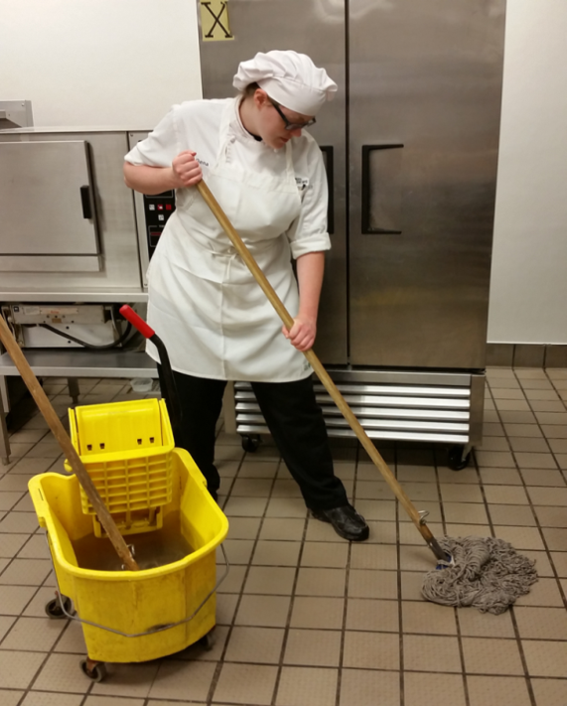
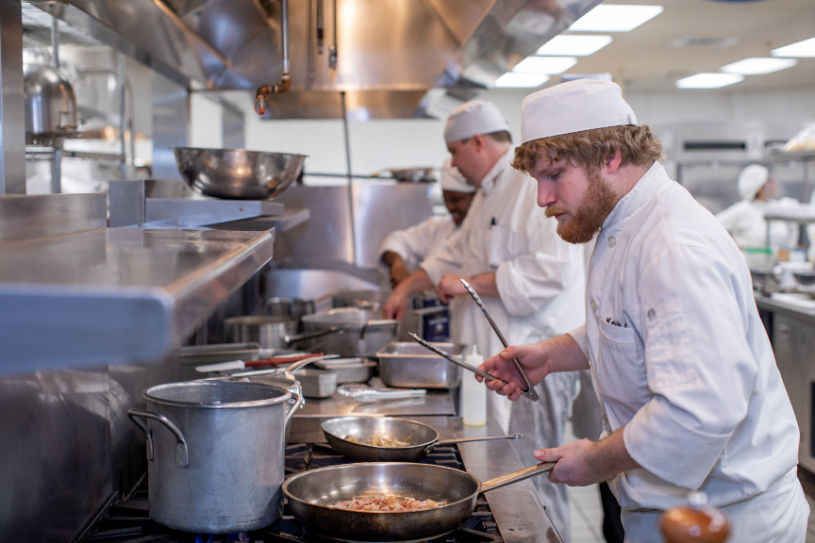
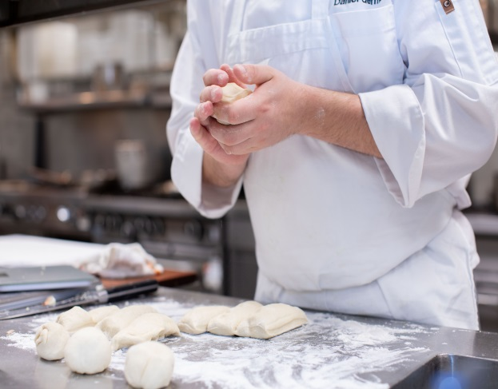
Technical Requirements
The hospitality industry is demanding
Communication
Physical Strength and Stamina
Mobility and Motor Skills
Sensory
Interpersonal and Emotional

Slide 18
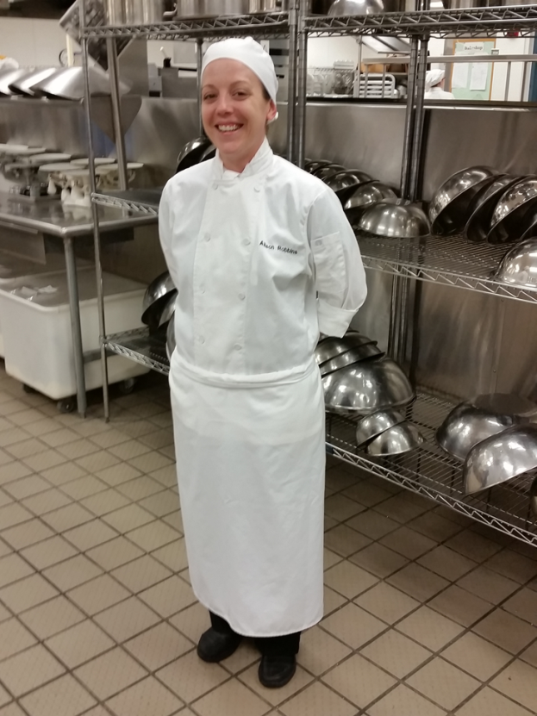
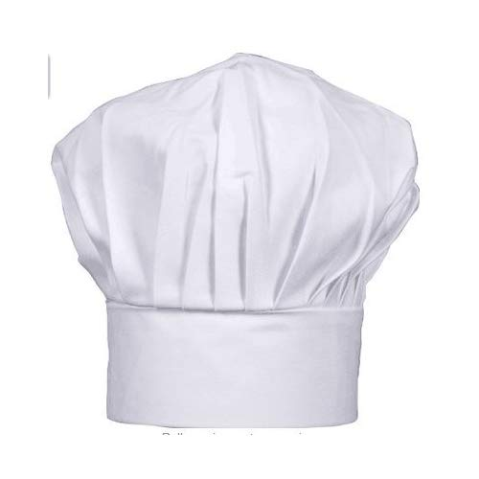
Uniform Policy
Why we wear what we wear
Hat
Neckerchief
Pants
Shoes
Apron
Chef Jacket
Name embroidered
Wear it proudly
Using Financial Aid
Walk into the kitchen in complete uniform. Dress in the locker rooms, not the kitchen.

Slide 19
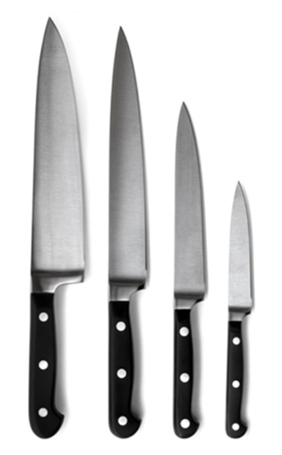
Knives and Tools
CHEF CULINARY SET
9" CHEF'S KNIFE-GENESIS
6" BONING KNIFE
11" WAVY EDGE SLICER
3" PARING KNIFE
10" STEEL-GENESIS
KITCHEN SHEARS
BENCH SCRAPER
8" OFFSET SPATULA
MICROPLANE GRATER W/ HANDLE
1" MELON BALLER
MEASURING SPOON SET
MEASURING CUP SET
16" POLYURETHANE PASTRY BAG
16" POLYURETHANE PASTRY BAG
SMALL DECORATING TUBE SET
#4 STAR TUBE
#4 PLAIN TUBE
POCKET THERMOMETER
SWIVEL PEELER-PLASTIC HANDLE
TRIPLE ZIP KNIFE CASE
DIGITAL SCALE

Slide 20
Knives and Tools
Baking Kit
5 PC. MODELING TOOL SET
FONDANT SMOOTHER
4 PIECE ARTIST BRUSH SET
SMALL COUPLER
LARGE DECORATING TUBE SET
PASTRY COMB
10" OFFSET SPATULA-PLASTIC HANDLE
HOBBY KNIFE
8" SPATULA-PLASTIC HANDLE
1" PASTRY BRUSH
FISH BONE PLIERS
FISH BONE TWEEZER - ANGLED TIP
4” TRIANGLULAR PASTRY SPATULA
FLUTED CUTTER SET-ROUND

Slide 21
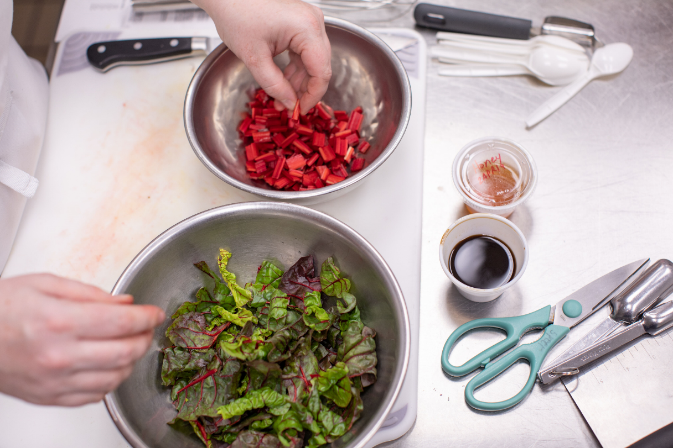
Knives and Tools
Other tools
Where to buy
Cost
Using Financial Aid

Slide 22
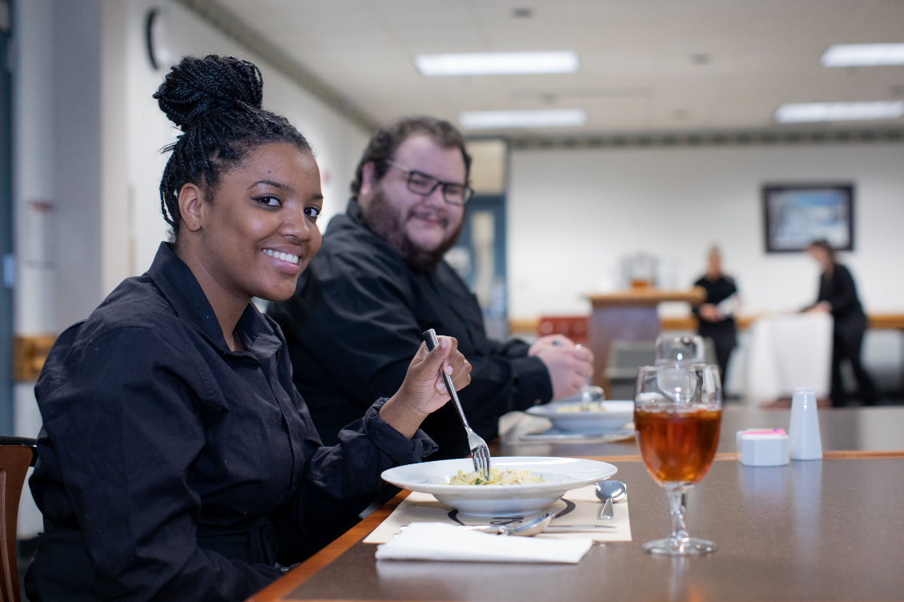
Flavors Restaurant
How it operates
How to make a reservation https://www.waketech.edu/flavors
Students as servers; students as cooks
Baking classes assist with providing desserts and breads

Slide 23
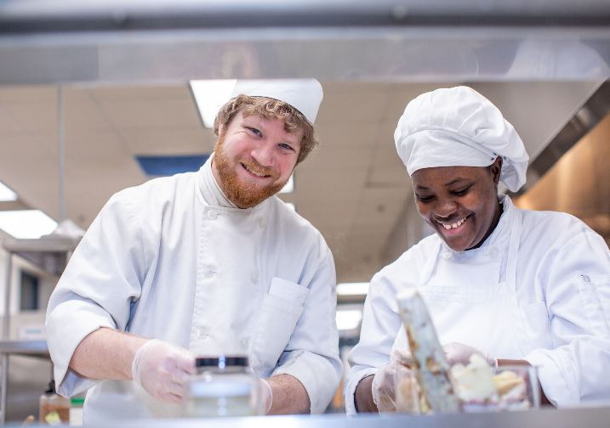
Work-Based Learning and Employment Resources
Why required
Requirements
Employment resources https://www.waketech.edu/about-wake-tech/careers-employment/careers
Study Abroad Opportunities

Slide 24
Once I Graduate, What Can I Expect?
Where can I find work after I graduate?
Student Success Stories http://www.waketech.edu/programs-courses/credit/baking-culinary-and-hospitality/graduate-job-placement
As a graduate, you can apply for Certified Culinarian® (CC®) or Certified Pastry Culinarian® (CPC®) with the American Culinary Federation (ACF).
Can I transfer to another school?
Will any of my credits transfer?

Slide 25
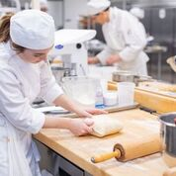
Tour of the Kitchens
Questions? / Comments?
How to contact us:
Jeff Hadley, Department Head for Culinary,
Baking, and Hospitality Programs
jjhadley@waketech.edu 919-866-5990
Tour of Kitchens
Culinary, Baking and Hospitality Website: http://www.waketech.edu/programs-courses/credit/baking-culinary-and-hospitality

